Slide 1
Store Sales Prediction Machine Learning Capstone Project
Suhas Ghatti
Mail Id- suhasmg98@gmail.com
Phone no- 7975807241
Batch no - 29

Slide 2
Process flow:
Objective
Understanding the data
Process followed in the project
Illustration of some plots
Conclusion
Result Table
Deductios from EDA process

Slide 3
Objective
The BigMart Stores Sales Prediction Project is a data science machine learning project that involves predicting the sales of a retail store chain, based on historical sales data. The goal of this project is to develop a machine learning model that can accurately forecast the sales of BigMart stores, which can help the company make informed decisions regarding inventory management, pricing strategies, and overall business planning.

Slide 4
Importance in the current world
Business optimization: Store sales prediction can help businesses optimize their operations by providing insights into expected sales volumes and trends. Accurate sales predictions can help businesses plan their inventory levels, manage staffing, and optimize pricing and promotions, leading to improved operational efficiency and profitability.
Online retail: With the growth of e-commerce and online retail, accurate sales predictions are important for managing online inventory, optimizing pricing and promotions, and planning online marketing campaigns.
Demand forecasting
Financial planning

Slide 5
Importance in the current world
COVID-19 impact: In the current scenario, where the retail industry has been significantly impacted by the COVID-19 pandemic, accurate sales predictions can help businesses adapt to changing consumer behavior, optimize operations, and make informed decisions about inventory management and resource allocation.
To analyze Customer experience with individual products based on the sales.
Marketing and sales strategy = by providing insights into sales trends, customer preferences, and product performance. This can help businesses tailor their marketing and sales efforts to maximize revenue and profitability.

Slide 6
Understanding the Data
Variables
Continuous
-Item_Weight
-Item_Visibility
- Item_MRP
- Outlet_Establishment_Year
- Item_Outlet_Sales
(Target variable)
Categorical
-Item_Identifier
-Item_Fat_Content
-Item_Type
-Outlet_Identifier
-Outlet_Size
-Outlet_Location_Type
-Outlet_Type

Slide 7
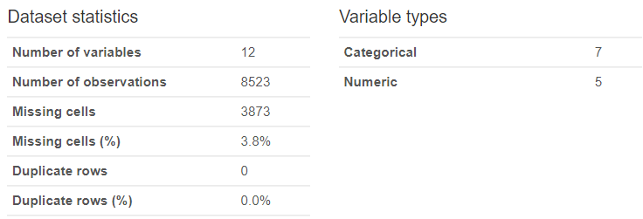
Understanding the Data

Slide 8
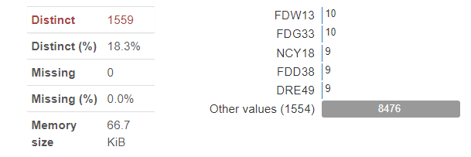
1.Item_Identifier
Item_Identifier : Unique product ID
By looking at first 2 letters of item identifier we can extract some information regarding food categories like: FD=“Food items”
DR= “Drinks”
NC= “Non Consumable goods”

Slide 9
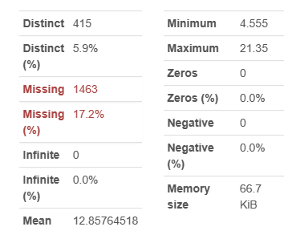
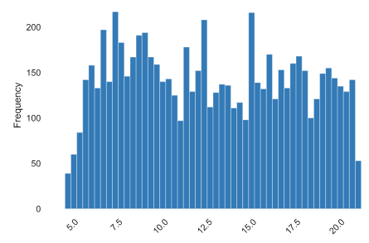
2.Item_Weight
Item_Weight: Weight of product
We have 17.2% missing values

Slide 10
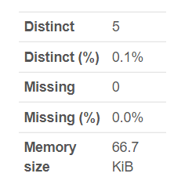
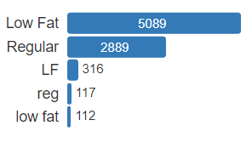
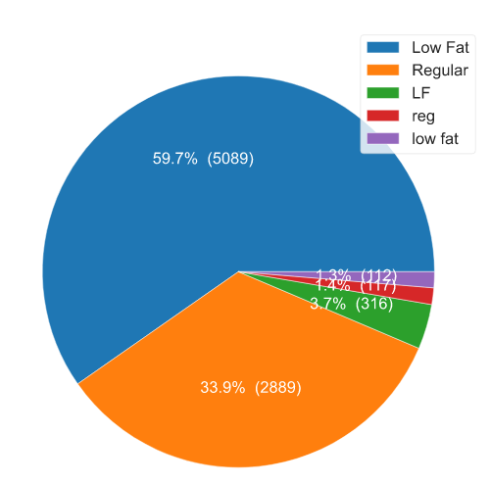
3. Item_Fat_Content
Item_Fat_Content= Whether the product is low fat or not.
There is error in the data which should be taken care while data cleaning process
NO missing values

Slide 11
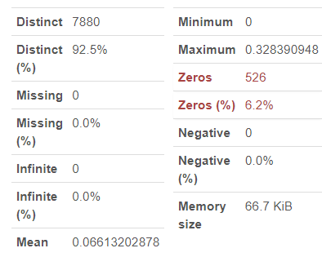
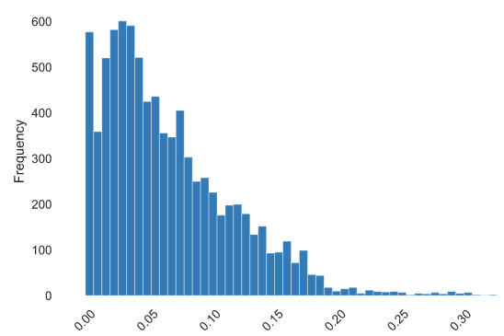
4. Item Visibility
Item_Visibility= The % of total display area of all products in a store allocated to the particular product
We can we in above chart that there are some zeros in the data which is not possible.

Slide 12
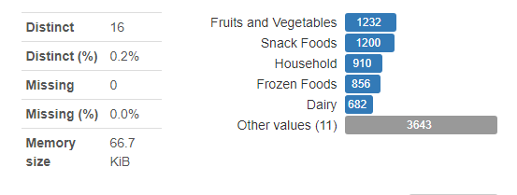
5. Item Type:
Item_Type = The category to which the product belongs
There are so many categories in the data. We can fix it and make some common categories using some other related columns
No missing values

Slide 13
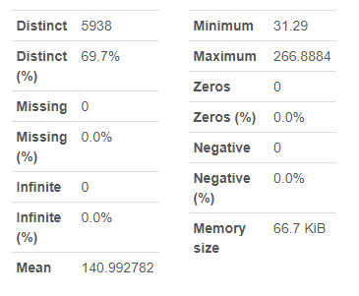
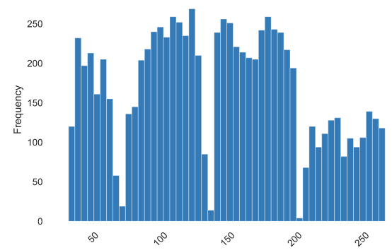
6. Item MRP:
Item_MRP = Maximum Retail Price (list price) of the product
This is highly correlated with the target variable among all the independent variables

Slide 14
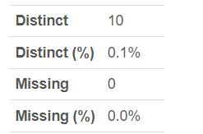
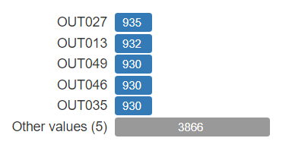
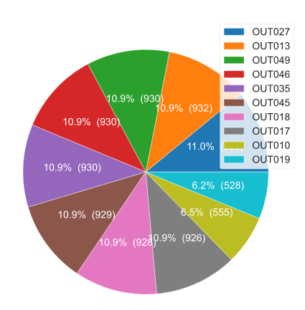
7. Outlet Identifier:
Outlet_Identifier = Unique store ID
It is helpful to study the store wise sales based on the location type, outlet type and year of established

Slide 15
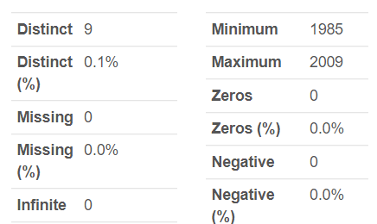
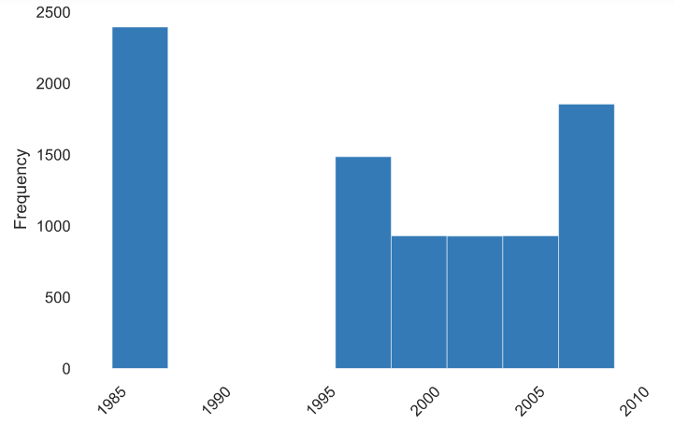
8. Outlet Established Year:
Outlet_Establishment_Year = The year in which store was established
The better way utilize this data is to converting it into how old the store is, this may be helpful for the model to understand the patterns

Slide 16
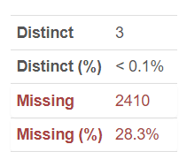
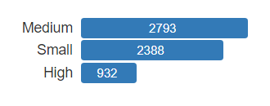
9. Outlet Size:
Outlet_Size = The size of the store in terms of ground area covered
There are 28% missing values

Slide 17
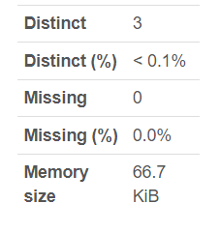
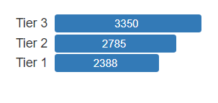
10. Outlet Location Type:
9. Outlet Location Type: The type of city in which the store is located
This is influencing more on outlet type data

Slide 18
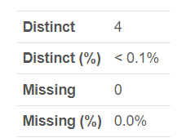
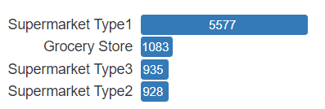
11. Outlet Type:
Outlet Type = Whether the outlet is just a grocery store or some sort of supermarket

Slide 19
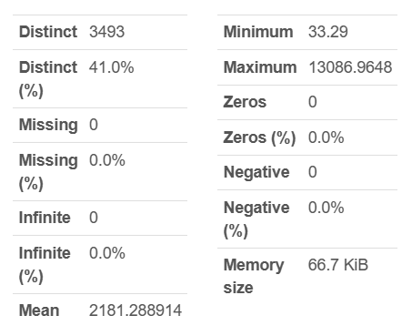
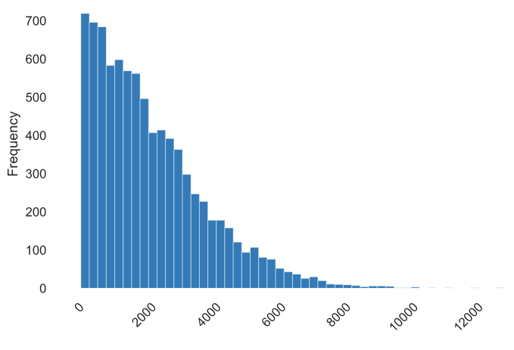
12. Item Outlet Sales:
Item Outlet Sales = Sales of the product in the particulate store. This is the outcome variable to be predicted

Slide 20
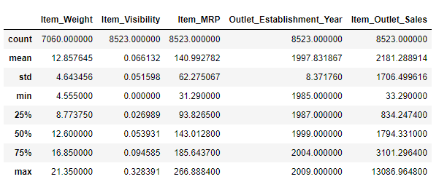
Data cleaning & preprocessing
The Item_Outlet_Sales has outliers.
The Item_Visibility has minimum value of 0. The Item_Visibility can't be zero. If the item has zero visibility, how can they sell the item?
So the zeros in the Item_Visibility are replaced by nun.
Item_Weight and Item_outlet_size has missing values.

Slide 21
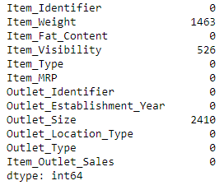
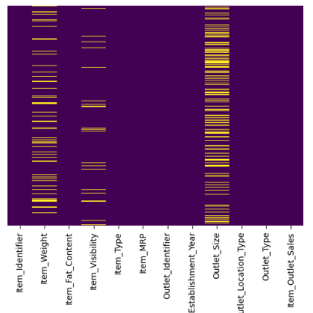
Data cleaning & preprocessing
So now we have null values in 3 variables
Item_Weight 17.1653 % missing values
Item_Visibility 6.1715 % missing values
Outlet_Size 28.2764 % missing values
Before imputing null values

Slide 22
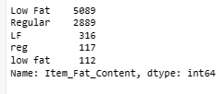
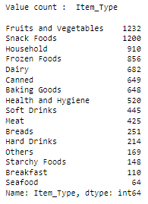
Data cleaning & preprocessing
The Item_Fat_Content has miscoded values. We need to fix them.
Low Fat, low fat and LF are same
Regular and reg are same
Item_Type has many categories.
It can be combined to fewer categories, like food items, drinks, non-veg items, etc.
From first 2 letters of feature Item_Identifier we can extract some useful information about food category
FD=“Food items”
DR= “Drinks”
NC= “Non Consumable goods”

Slide 23

Data cleaning & preprocessing
since we have only 2 categories in 'Item_Fat_Content' based on the observations from 'Item_Identifier' we have to add one more category to the 'Item_Fat_Content‘
ie. 'Non consumable'
Outlet_Establishment_Years vary from 1985 to 2009. The values might not be apt in this form. Rather, if we can convert them to how old the particular store is, it should have a better impact on sales.¶

Slide 24
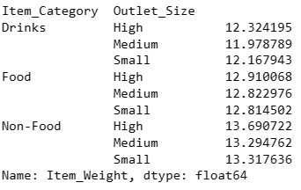
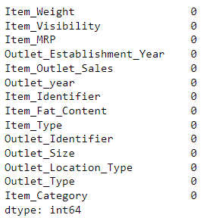
Data cleaning & preprocessing
Imputing null values of Outlet_size with mode.
Some of the missing values are imputed by taking reference of Item_Category
And remaining null values are imputed using iterative imputer function
Some of the missing values are imputed by taking reference of Item_Category
And remaining null values are imputed using iterative imputer function

Slide 25
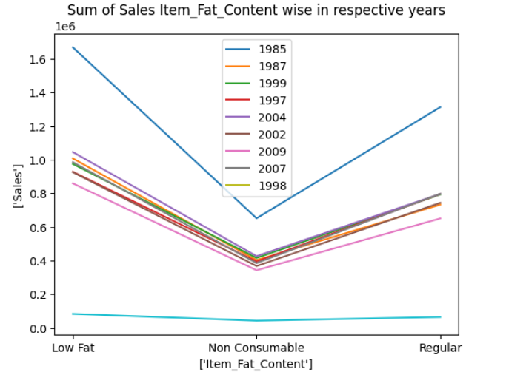
We can see here how the sales of different item fat content varies with the year of establishment

Slide 26
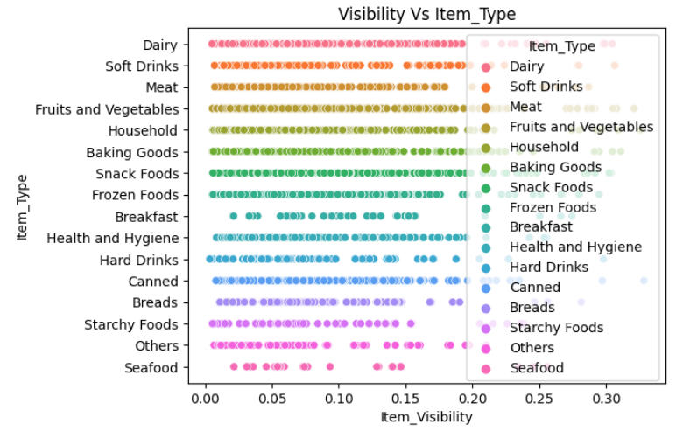
In the graph we can see that item visibility is not depending upon the item type. All the type of items have wide range of visibilities

Slide 27
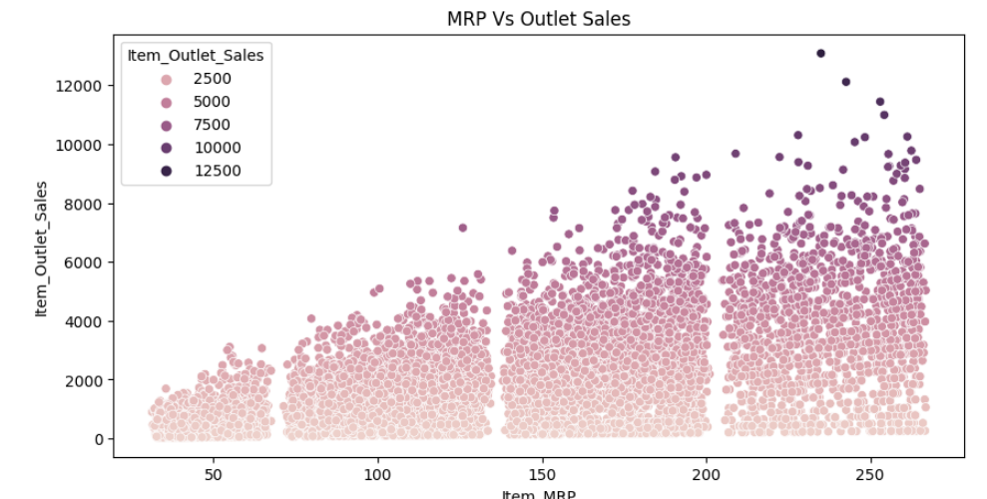
The items having higher price are contributing more for the total sales

Slide 28
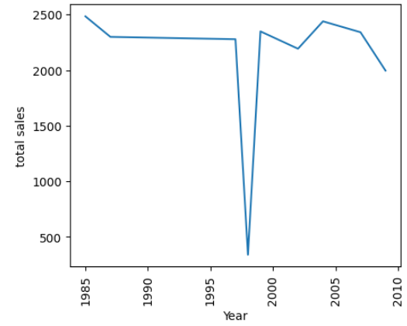
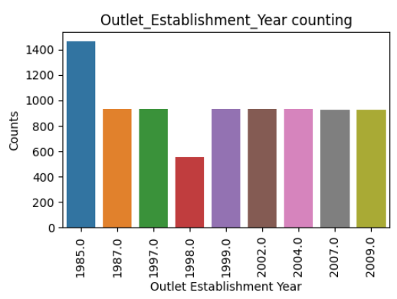
Total sales should be increase as older the store gets but in the year 1998 the number of outlets and total sales got sudden decrease

Slide 29
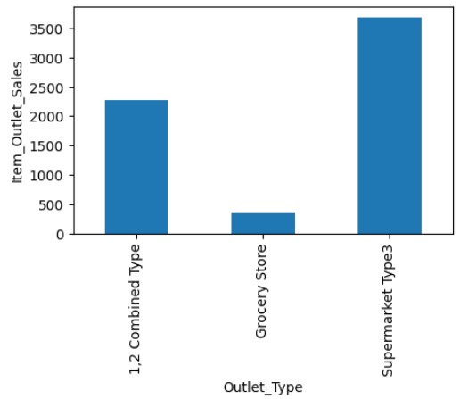
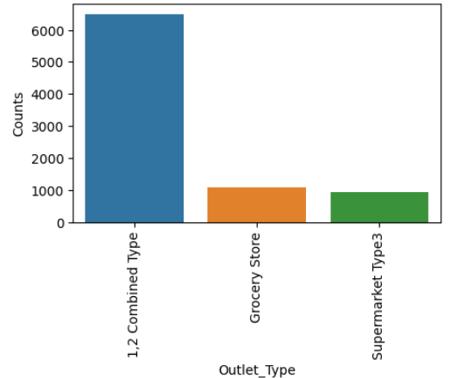
Even though the count of “1,2 Combined type” stores have higher counts the Supermarket Type 3 has higher sales

Slide 30
Result Table:
S.No. | Model | Train R2 | Test R2
1 | linear Regression | 0.31 | 0.30
2 | KNNeighbors | 0.73 | 0.71
3 | Decision Tree | 0.69 | 0.71
4 | Random Forest | 0.73 | 0.74
5 | AdaBoost | 0.69 | 0.71
6 | Gradient Boosting | 0.75 | 0.75

Slide 31
Conclusion:

